Slide 1
Sequence Representation of Data

Slide 2
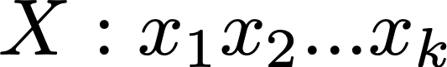
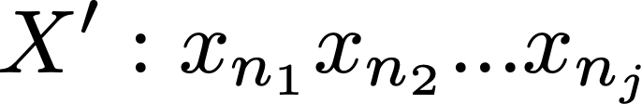

Subsequence
X’ is a subsequence of X after dropping items in X and keeping the order
(Original Sequence)
(Subsequence)
All items in X’ are part of the original sequence (X): n_{j} is a number among 1, 2,…, k.

Slide 3

Example of subsequences
“to be or not to be”
e.g., subsequences length 3:
“to be or”, “be or not”, “or not to”, “not to be”
(Consecutive subsequence)
“to be not”, “be not be”, “to to be”, “to or not”, …
(Non-consecutive subsequence)
“not be to”, “or be be”

Slide 4


School of Information, University of Michigan
Qiaozhu Mei
School of Information
All Content © Presenter

